Slide 1
Introduction
Apache Hive is an open source data warehouse system built on top of Hadoop. It is used for querying and analyzing large datasets stored in Hadoop files. It process structured and semi-structured data in Hadoop.
Initially, you have to write complex Map-Reduce jobs, but now with the help of the Hive, you just need to submit merely SQL queries. Hive is mainly targeted towards users who are comfortable with SQL. Hive use language called HiveQL (HQL), which is similar to SQL. HiveQL automatically translates SQL-like queries into MapReduce jobs.
Hive abstracts the complexity of Hadoop. The main thing to notice is that there is no need to learn java for Hive.
The Hive generally runs on your workstation and converts your SQL query into a series of jobs for execution on a Hadoop cluster. Apache Hive organizes data into tables. This provides a means for attaching the structure to data stored in HDFS.

Slide 2
Why Apache Hive?
Facebook had faced a lot of challenges before the implementation of Apache Hive. Challenges like the size of the data being generated increased or exploded, making it very difficult to handle them. The traditional RDBMS could not handle the pressure. Hence, Apache Hive allowed them to overcome the challenges they were facing.
With Apache Hive, they are now able to perform the following:
Schema flexibility and evolution
Tables can be partitioned and bucketed
Apache Hive tables are defined directly in the HDFS
JDBC/ODBC drivers are available

Slide 3
Why Apache Hive?
Apache Hive saves developers from writing complex Hadoop MapReduce/Spark jobs for ad-hoc requirements. Hence, hive provides summarization, analysis, and query of data.
Hive is very fast and scalable. It is highly extensible.
Hive is similar to SQL, hence it becomes very easy for the SQL developers to learn and implement Hive Queries.
Hive reduces the complexity of MapReduce by providing an interface where the user can submit SQL queries. So, now business analysts can play with Big Data using Apache Hive and generate insights.
The most important feature of Apache Hive is that to learn Hive we don’t have to learn Java.

Slide 4
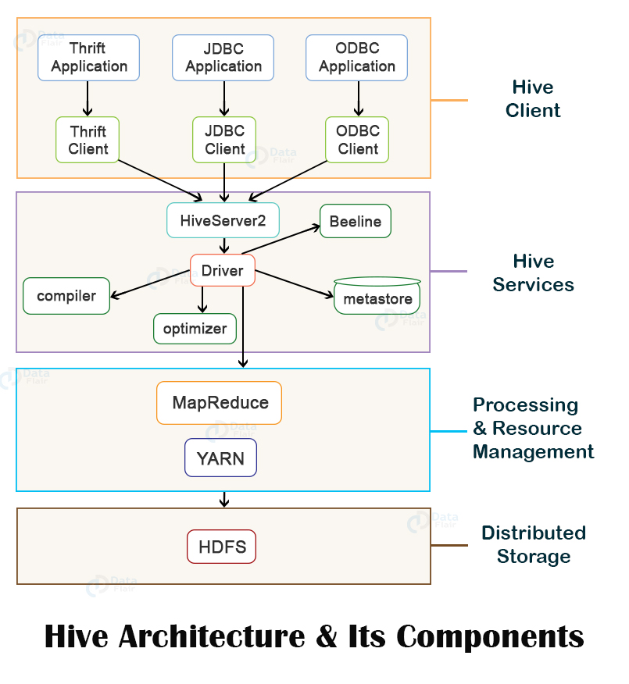

Slide 5
Hive Client
Hive supports applications written in any language like Python, Java, C++, Ruby, etc. using JDBC, ODBC, and Thrift drivers, for performing queries on the Hive. Hence, one can easily write a hive client application in any language of its own choice.
Hive clients are categorized into three types:
1. Thrift Clients
The Hive server is based on Apache Thrift so that it can serve the request from a thrift client.
2. JDBC client
Hive allows for the Java applications to connect to it using the JDBC driver. JDBC driver uses Thrift to communicate with the Hive Server.
3. ODBC client
Hive ODBC driver allows applications based on the ODBC protocol to connect to Hive. Similar to the JDBC driver, the ODBC driver uses Thrift to communicate with the Hive Server.

Slide 6
Hive Service
1. Beeline
The Beeline is a command shell supported by HiveServer2, where the user can submit its queries and command to the system. It is a JDBC client that is based on SQLLINE CLI (pure Java-console based utility for connecting with relational database and executing SQL queries).
2. Hive Server 2
HiveServer2 enables clients to execute queries against the Hive. It allows multiple clients to submit requests to Hive and retrieve the final results. It is basically designed to provide the best support for open API clients like JDBC and ODBC.

Slide 7
3. Hive Driver
The Hive driver receives the HiveQL statements submitted by the user through the command shell. It creates the session handles for the query and sends the query to the compiler.
4. Hive Compiler
Hive compiler parses the query. It performs semantic analysis and type-checking on the different query blocks and query expressions by using the metadata stored in metastore and generates an execution plan.
The execution plan created by the compiler is the DAG(Directed Acyclic Graph), where each stage is a map/reduce job, operation on HDFS, a metadata operation.
5. Optimizer
Optimizer performs the transformation operations on the execution plan and splits the task to improve efficiency and scalability.

Slide 8
6. Execution Engine
Execution engine, after the compilation and optimization steps, executes the execution plan created by the compiler in order of their dependencies using Hadoop. (MR, Spark)
7. Metastore
Metastore is a central repository that stores the metadata information about the structure of tables and partitions, including column and column type information.
It also stores information of serializer and deserializer, required for the read/write operation, and HDFS files where data is stored. This metastore is generally a relational database.

Slide 9
8. HCatalog
HCatalog is the table and storage management layer for Hadoop. It enables users with different data processing tools such as Pig, MapReduce, etc. to easily read and write data on the grid. It is built on the top of Hive metastore and exposes the tabular data of Hive metastore to other data processing tools.

Slide 10
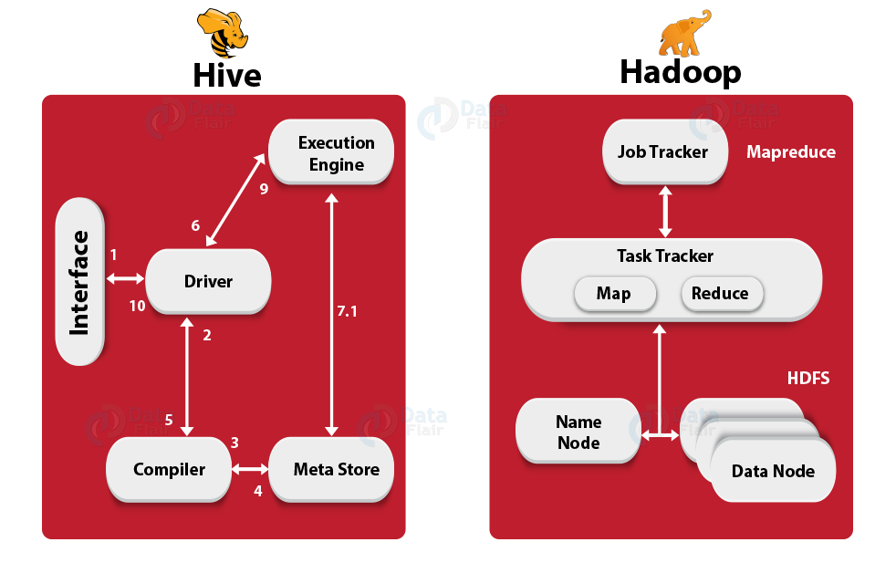
Working of Hive

Slide 11
Step-1 Execute Query
At very first, the Hive interface ( Command Line or Web UI) sends the query to Driver (any database driver such as JDBC, ODBC, etc.) to execute.
Step-2 Get Plan
Afterwards, the driver takes the help of query compiler which parses the query to check the syntax and query plan or the requirement of the query.
Step-3 Get Metadata
Further, the compiler sends metadata request to Metastore (any database).
Step-4 Send Metadata
After that Metastore sends metadata as a response to the compiler.

Slide 12
Step-5 Send Plan
Then the compiler checks the requirement and resends the plan to the driver. However, the parsing and compiling of a query are complete, Up to here.
Step-6 Execute Plan
Further, the driver sends the execution plan to the execution engine.
Step-7 Execute Job
Then, the process of execution job is a MapReduce job, internally. Also, the execution engine sends the job to Resource Manager for execution. Moreover, the query executes MapReduce/Spark job, here.
Metadata Ops
During the execution, the execution engine can execute metadata operations with Metastore with the help of hcatalog api.

Slide 13
Step-8 Fetch Result
While execution is over, the execution engine receives the results from Data nodes.
Step-9 Send Results
After fetching results, execution engine sends those resultant values to the driver.
Step-10 Send Results
At last the driver sends the results to Hive interfaces.

Slide 14
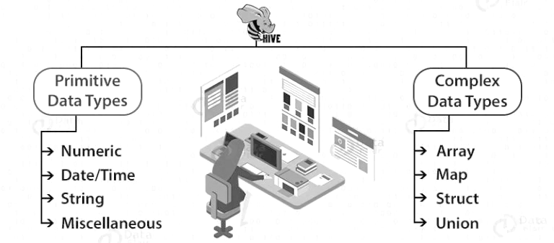
Hive Types, Functions and DataModels

Slide 15
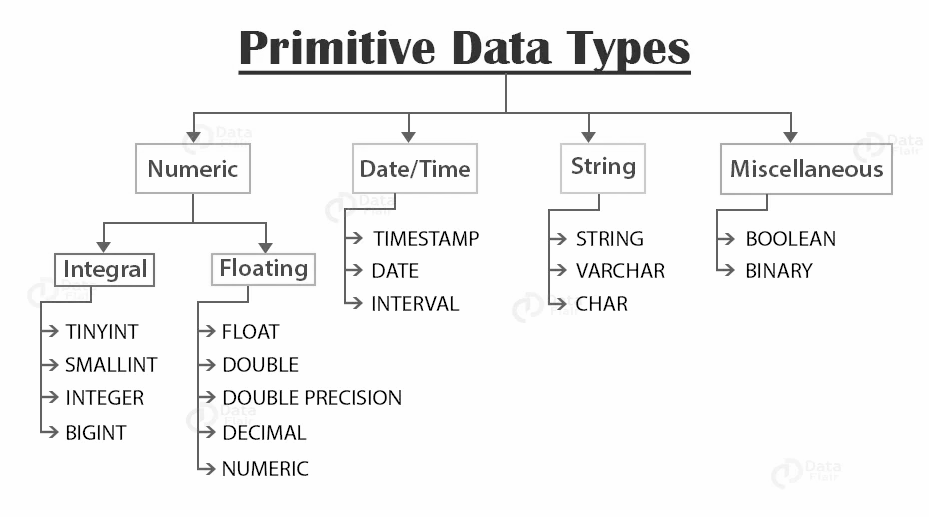

Slide 16
Integral data type
TINYINT – (1-byte signed integer ranging from -128 to 127)
SMALLINT – (2-byte signed integer ranging from -32, 768 to 32, 767)
INTEGER – (4-byte signed integer ranging from -2, 147, 483, 648 to 2, 147, 483, 647)
BIGINT – (8-byte signed integer ranging from -9, 223, 372, 036, 854, 775, 808 to 9, 223, 372, 036, 854, 775, 807)
In Hive, Integral literals are assumed to be INTEGER by default unless they cross the range of INTEGER values. If we want to use a low integral value like 100 to be treated as TINYINT, SMALLINT, or BIGINT, then we will use the following postfixes (shown in the below table) with the number.
Type | Postfix | Example
TINYINT | Y | 100Y
SMALLINT | S | 100S
BIGINT | L | 100L

Slide 17
Floating data type
FLOAT : It is a 4-byte single-precision floating-point number.
DOUBLE : It is an 8-byte double-precision floating-point number.
DECIMAL : It was introduced in Hive 0.11.0. It is based on Java’s BigDecimal. DECIMAL types support both scientific and non-scientific notations. User can specify the scale and precision during table creation using the syntax:
DECIMAL(precision, scale) : If precision is not specified, then by default, it is equal to 10.
If the scale is not specified, then by default, it is equal to 0.
DECIMAL provides more precise values and greater range than DOUBLE.
NUMERIC
It started with Hive 3.0.0. The NUMERIC data type is the same as the DECIMAL type.

Slide 18
Date/Time data type
TIMESTAMP
It supports traditional UNIX timestamp with the optional nanosecond precision. The supported Timestamps format is yyyy-mm-dd hh:mm:ss[.f…] in the text files.
java.sql.Timestamp format “YYYY-MM-DD HH:MM:SS.fffffffff” (9 decimal place precision)
For example- ‘2020-02-04 01:01:01.100 ’
DATE
DATE value describes a particular year/month/day in the form of YYYY-MM-DD.
For example- ‘2020-02-04’
INTERVAL - Hive accepts the interval syntax with unit specifications. We have to specify the units along with the interval value.

Slide 19
Supported Interval Description | Examples along with units
SECOND | INTERVAL ‘1’ SECOND
MINUTE | INTERVAL ‘1’ MINUTE
HOUR | INTERVAL ‘1’ HOUR
DAY | INTERVAL ‘1’ DAY
MONTH | INTERVAL ‘1’ MONTH
YEAR | INTERVAL ‘1’ YEAR

Slide 20
select current_date;
+-------------+--+
| _c0 |
+-------------+--+
| 2019-07-17 |
+-------------+--+
1 row selected (0.195 seconds)
> select current_date + interval '1' day;
+------------------------+--+
| _c0 |
+------------------------+--+
| 2019-07-18 00:00:00.0 |
+------------------------+--+
1 row selected (0.186 seconds)
select current_date + interval '10' hour;
+------------------------+--+
| _c0 |
+------------------------+--+
| 2019-07-17 10:00:00.0 |
+------------------------+--+
1 row selected (0.351 seconds)
select current_date + interval '10' second;
+------------------------+--+
| _c0 |
+------------------------+--+
| 2019-07-17 00:00:10.0 |
+------------------------+--+
1 row selected (0.282 seconds)

Slide 21
String data type :
STRING - String literals are represented either with the single quotes(‘ ’) or with double-quotes(“ ”).
VARCHAR - VARCHAR data types are of different lengths, but we have to specify the maximum number of characters allowed in the character string. If the string value assigned to the varchar is less than the maximum length, then the remaining space will be freed out. Also, if the string value assigned is more than the maximum length, then the string is silently truncated. The length of the varchar is between(1 to 65535). Trailing whitespace is important in varchar and will affect the comparison results.
CHAR - CHAR data types are fixed-length.
The values shorter than the specified length are padded with the spaces.
Unlike VARCHAR, trailing spaces are not significant in CHAR types during comparisons

Slide 22
Data Type Selection
The recommendation is to use VARCHAR and Integer Types (TINYINT, SMALLINT, INT, BIGINT) where ever possible instead of using String. In hive String is treated as VARCHAR(32762). So, if you have data that is not more than 50 characters in length, using string here will have some overhead.
Char types are similar to Varchar but they are fixed-length meaning that values shorter than the specified length value are padded with spaces but trailing spaces are not important during comparisons.

Slide 23
Miscellaneous data type
BOOLEAN
Boolean types in Hive store either true or false.
BINARY
BINARY type in Hive is an array of bytes.

Slide 24
Complex Types
Array
Map
Struct

Slide 25
Array:
$ cat > arrayfile
1,abc,40000,a$b$c,hyd
2,def,3000,d$f,bang
hive> create table tab7 (id int,name string,sal bigint,sub array<string>,city string)
row format delimited fields terminated by ',' collection items terminated by '$';
hive> load data local inpath '/home/training/arrayfile' overwrite into table tab10;
hive> select sub[2] from tab7 where id=1;
c
hive> select sub[0] from tab7;
a

Slide 26
Maps:
$ cat> mapfile
1,abc,40000,a$b$c,pf#500$epf#200,hyd
2,def,3000,d$f,pf#500,bang
hive>create table tab10(id int,name string,sal bigint,sub array<string>,dud map<string,int>,city string)
row format delimited fields terminated by ',' collection items terminated by '$' map keys terminated by '#';
hive> load data local inpath '/home/training/mapfile' overwrite into table tab10;
hive>select dud["pf"] from tab10;
500
hive>select dud["pf"],dud["epf"] from tab10;
500, 200

Slide 27
STRUCT :
cat > structfile
1,abc,40000,a$b$c,pf#500$epf#200,hyd$ap$500001
2,def,3000,d$f,pf#500,bang$kar$600038
hive> create table tab11 (id int,name string,sal bigint,sub array<string>,dud map<string,int>,addr struct<city:string,state:string,pin:bigint>) row format delimited fields terminated by ',' collection items terminated by '$' map keys terminated by '#';
hive> load data local inpath '/home/training/structfile' into table tab11;
hive>select addr.city from tab11;
hyd
bang

Slide 28
Collection Functions
INT size(Map<K.V>)
It will fetch and give the components number in the map type
INT size(Array<T>)
It will fetch and give the elements number in the array type
select size(array(1,3,5,2,5));
+------+--+
| _c0 |
+------+--+
| 5 |
+------+--+
Array<K> Map_keys(Map<K.V>)
It will fetch and gives an array containing the keys of the input map. Here array is in unordered
Array<V> Map_values(Map<K.V>)
It will fetch and gives an array containing the values of the input map. Here array is in unordered
Array<t> Sort_array(Array<T>)
sorts the input array in ascending order of array and elements and returns it

Slide 29
Hive Date Functions
Unix_Timestamp()
Unix_Timestamp()
We will get current Unix timestamp in seconds
To_date(string timestamp)
string
It will fetch and give the date part of a timestamp string:
year(string date)
INT
It will fetch and give the year part of a date or a timestamp string
quarter(date/timestamp/string)
INT
It will fetch and give the quarter of the year for a date, timestamp, or string in the range 1 to 4
month(string date)
INT
It will give the month part of a date or a timestamp string
hour(string date)
INT
It will fetch and gives the hour of the timestamp
minute(string date)
INT
It will fetch and gives the minute of the timestamp

Slide 30
Date_sub(string starting date, int days)
string
It will fetch and gives Subtraction of number of days to starting date
Current_date
date
It will fetch and gives the current date at the start of query evaluation
LAST _day(string date)
string
It will fetch and gives the last day of the month which the date belongs to
trunc(string date, string format)
string
It will fetch and gives date truncated to the unit specified by the format.
Supported formats in this :
MONTH/MON/MM, YEAR/YYYY/YY.

Slide 31
Mathematical Functions
round(DOUBLE X)
DOUBLE
It will fetch and returns the rounded BIGINT value of X
round(DOUBLE X, INT d)
DOUBLE
It will fetch and returns X rounded to d decimal places
bound(DOUBLE X)
DOUBLE
It will fetch and returns the rounded BIGINT value of X using HALF_EVEN rounding mode
floor(DOUBLE X)
BIGINT
It will fetch and returns the maximum BIGINT value that is equal to or less than X value
ceil(DOUBLE a), ceiling(DOUBLE a)
BIGINT
It will fetch and returns the minimum BIGINT value that is equal to or greater than X value
rand(), rand(INT seed)
DOUBLE
It will fetch and returns a random number that is distributed uniformly from 0 to 1

Slide 32
Hive String Functions
reverse(string X)
string
It will give the reversed string of X
rpad(string str, int length, string pad)
string
It will fetch and gives str, which is right-padded with the pad to a length of length(integer value)
rtrim(string X)
string
It will fetch and returns the string resulting from trimming spaces from the end (right-hand side) of X For example, rtrim(‘ results ‘) results in ‘ results’
space(INT n)
string
It will fetch and gives a string of n spaces.
split(STRING str, STRING pat)
array
Splits str around pat (pat is a regular expression).
Str_to_map(text[, delimiter1, delimiter2])
map<String ,String>
It will split text into key-value pairs using two delimiters.

Slide 33
Conditional Functions
if(Boolean testCondition, T valueTrue, T valueFalseOrNull)
T
It will fetch and gives value True when Test Condition is of true, gives value False Or Null otherwise.
ISNULL( X)
Boolean
It will fetch and gives true if X is NULL and false otherwise.
ISNOTNULL(X )
Boolean
It will fetch and gives true if X is not NULL and false otherwise.

Slide 34
Hive DDL Commands
DDL Command | Use With
CREATE | Database, Table
SHOW | Databases, Tables, Table Properties, Partitions, Functions, Index
DESCRIBE | Database, Table, view
USE | Database
DROP | Database, Table
ALTER | Database, Table
TRUNCATE | Table

Slide 35
Before moving forward, note that the Hive commands are case-insensitive.
CREATE DATABASE is the same as create database.
CREATE (DATABASE|SCHEMA) [IF NOT EXISTS] database_name
SHOW (DATABASES|SCHEMAS);
DESCRIBE DATABASE/SCHEMA [EXTENDED] db_name;
USE database_name;
DROP (DATABASE|SCHEMA) [IF EXISTS] database_name [RESTRICT|CASCADE];
The default behavior is RESTRICT which means that the database is dropped only when it is empty. To drop the database with tables, we can use CASCADE.
ALTER (DATABASE|SCHEMA) database_name SET OWNER [USER|ROLE] user_or_role;
ALTER (DATABASE|SCHEMA) database_name SET DBPROPERTIES (property_name=property_value, ...);
ALTER (DATABASE|SCHEMA) database_name SET LOCATION hdfs_path;
Note: The ALTER DATABASE … SET LOCATION statement does not move the database current directory contents to the newly specified location. This statement does not change the locations associated with any tables or partitions under the specified database. Instead, it changes the default parent-directory, where new tables will be added for this database.

Slide 36
CREATE TABLE [IF NOT EXISTS] [db_name.] table_name [(col_name data_type [COMMENT col_comment], ... [COMMENT col_comment])] [COMMENT table_comment] [ROW FORMAT row_format] [STORED AS file_format] [LOCATION hdfs_path];
Create table db.name(id string, sal double)
SHOW TABLES [IN database_name];
SHOW TABLES db;
DESCRIBE [EXTENDED|FORMATTED] [db_name.] table_name[.col_name ( [.field_name])];
DESCRIBE FORMATTED db.table_name;

Slide 37
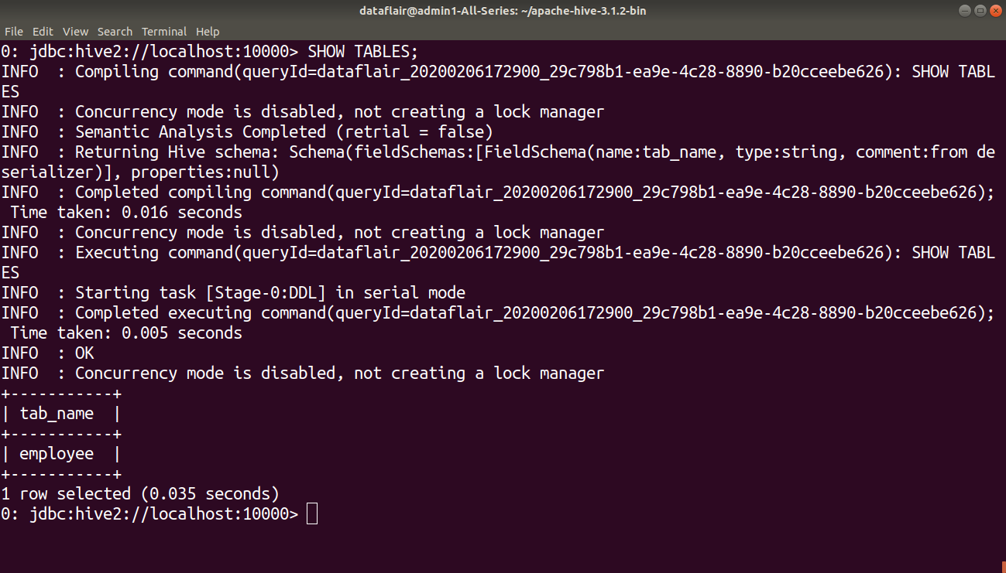
SHOW TABLES [IN database_name];

Slide 38
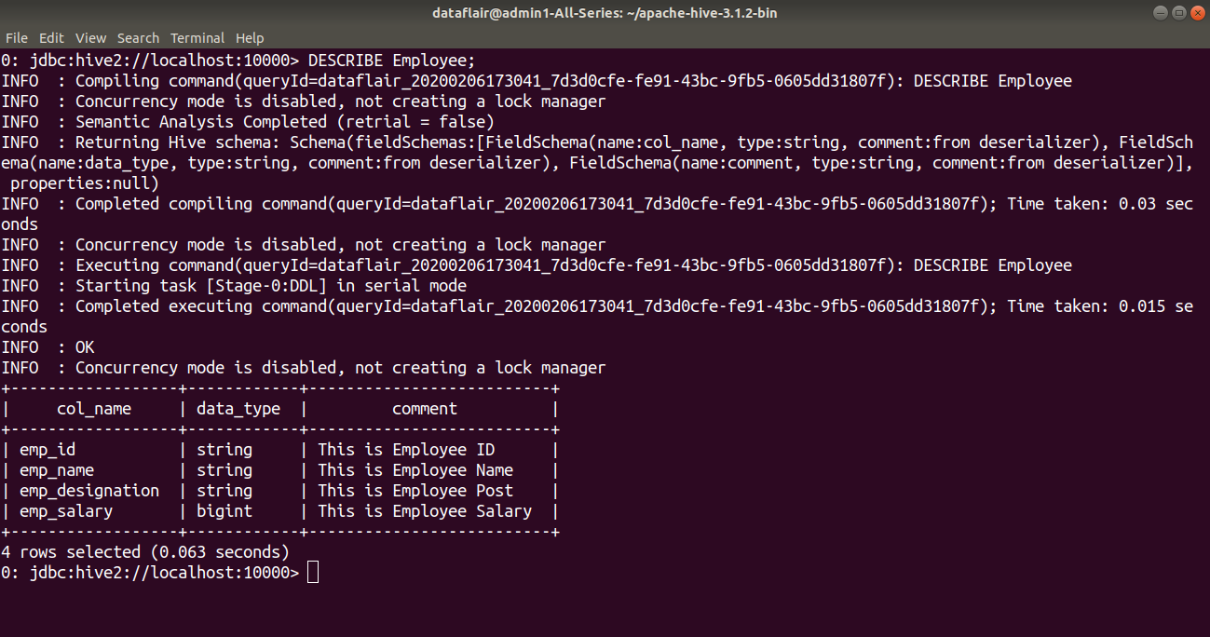
DESCRIBE [EXTENDED|FORMATTED] [db_name.] table_name

Slide 39
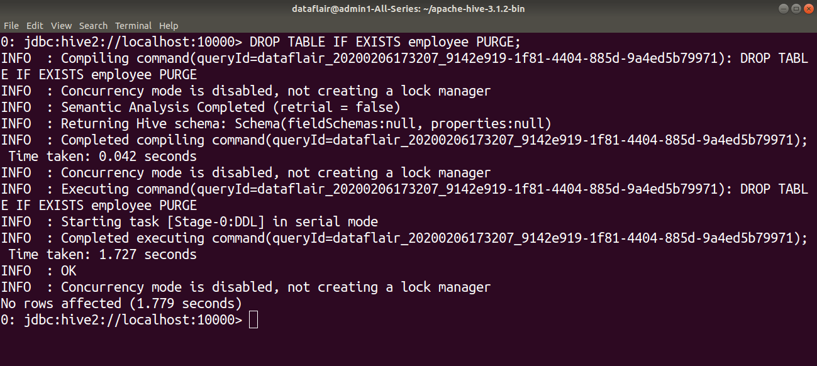
DROP TABLE [IF EXISTS] table_name [PURGE]; If PURGE is not specified then the data is actually moved to the .Trash/current directory. If PURGE is specified, then data is lost completely.

Slide 40
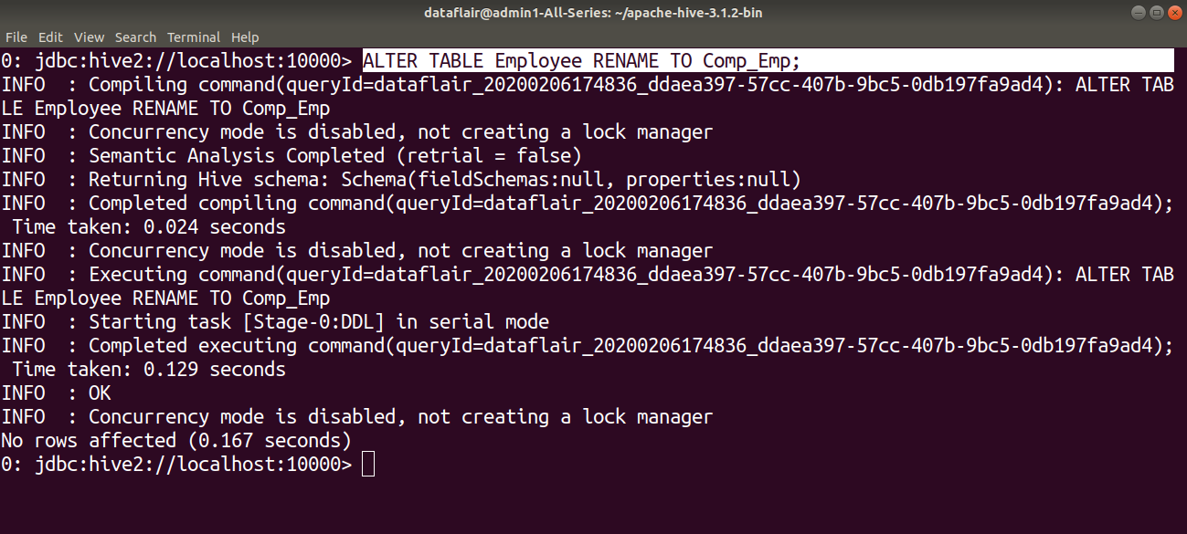
ALTER TABLE table_name RENAME TO new_table_name; In this example, we are trying to rename the ‘Employee’ table to ‘Com_Emp’ using the ALTER statement

Slide 41


Slide 42
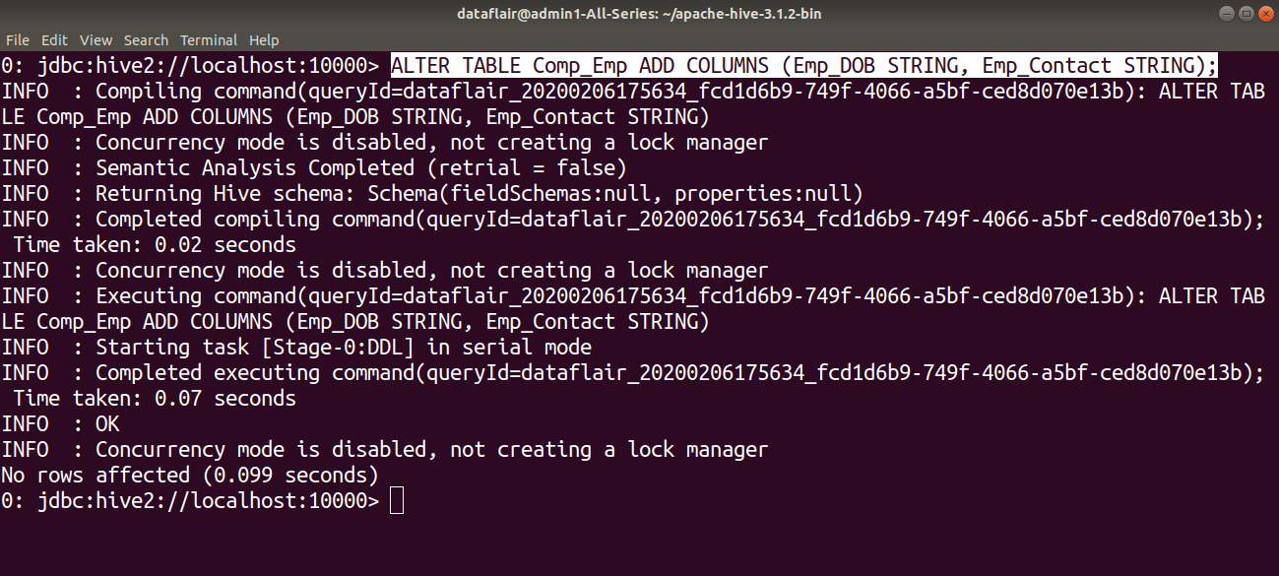
ALTER TABLE table_name ADD COLUMNS (column1, column2) ; In this example, we are adding two columns ‘Emp_DOB’ and ‘Emp_Contact’ in the ‘Comp_Emp’ table using the ALTER command.

Slide 43
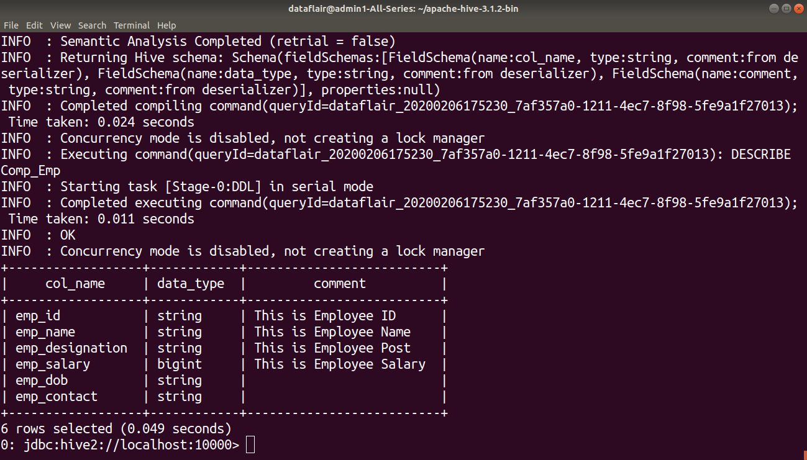

Slide 44
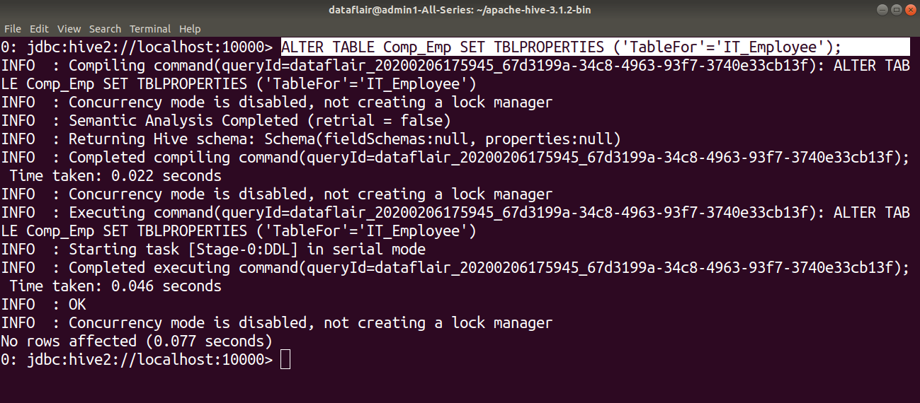
ALTER TABLE table_name SET TBLPROPERTIES (‘property_key’=’property_new_value’);we are setting the table properties after table creation by using ALTER command.

Slide 45
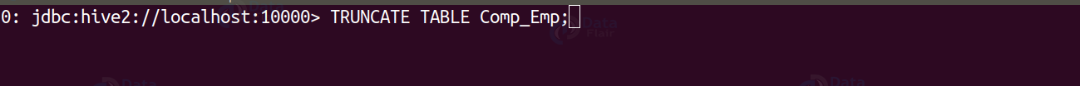
TRUNCATE TABLE table_name; removes all the rows from the table or partition.

Slide 46
Hive DML commands
The various Hive DML commands are:
LOAD
SELECT
INSERT
DELETE

Slide 47
LOAD Command
The LOAD statement in Hive is used to move data files into the locations corresponding to Hive tables.
If a LOCAL keyword is specified, then the LOAD command will look for the file path in the local filesystem.
If the LOCAL keyword is not specified, then the Hive will need the absolute URI of the file.
In case the keyword OVERWRITE is specified, then the contents of the target table/partition will be deleted and replaced by the files referred by filepath.
If the OVERWRITE keyword is not specified, then the files referred by filepath will be appended to the table.

Slide 48
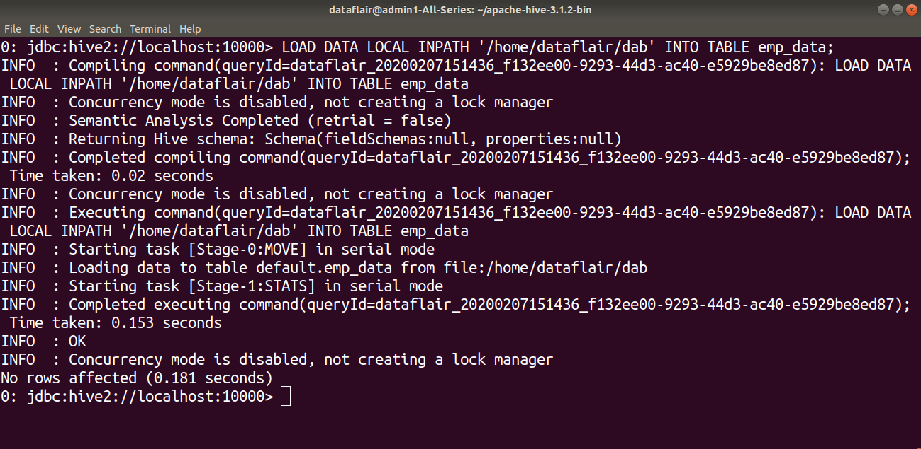
LOAD DATA [LOCAL] INPATH 'filepath' [OVERWRITE] INTO TABLE tablename [PARTITION (partcol1=val1, partcol2=val2 ...)]; Here we are trying to load data from the ‘dab’ file in the local filesystem to the ‘emp_data’ table.

Slide 49
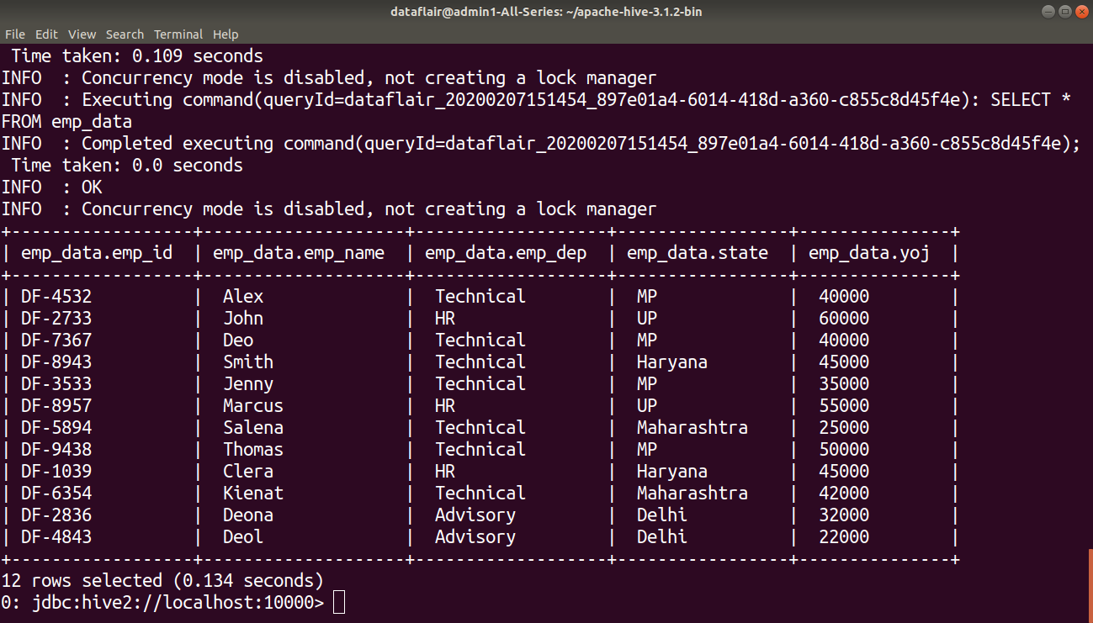

Slide 50
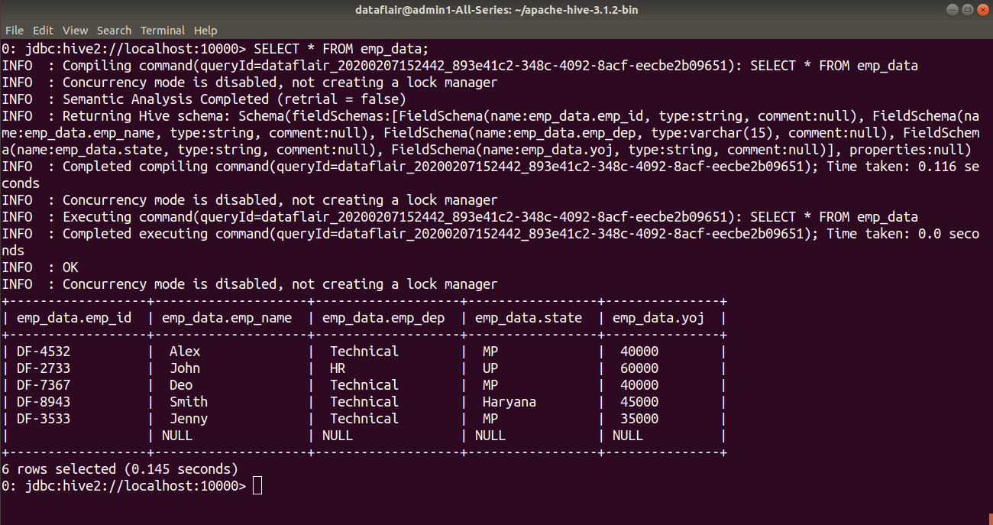
SELECT col1,col2 FROM tablename;

Slide 51
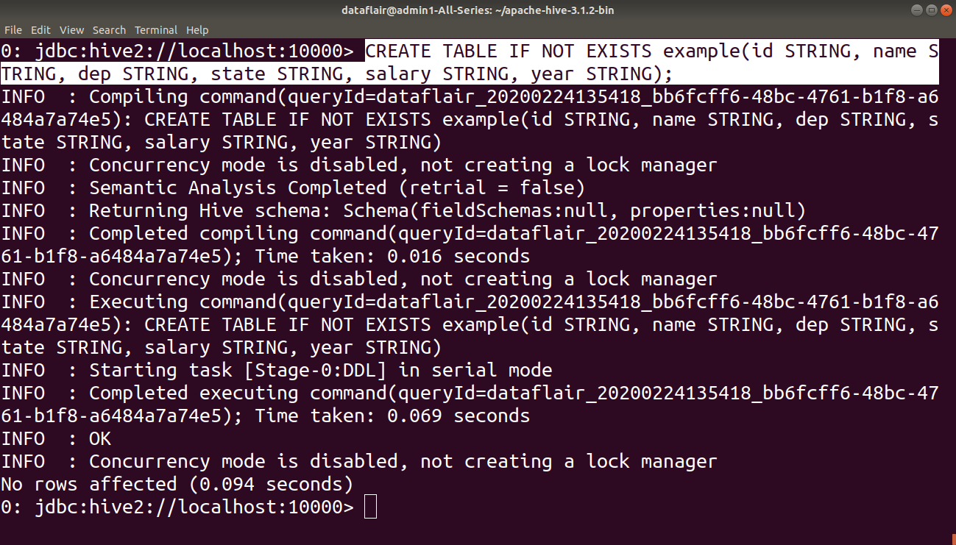
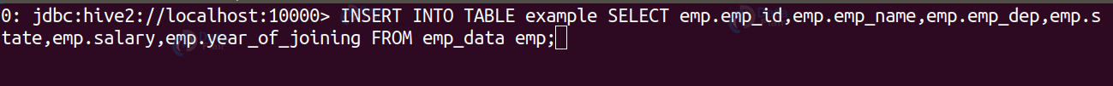
INSERT INTO TABLE tablename1 [PARTITION (partcol1=val1, partcol2=val2 ...)] select_statement1 FROM from_statement;The INSERT INTO statement appends the data into existing data in the table or partition

Slide 52
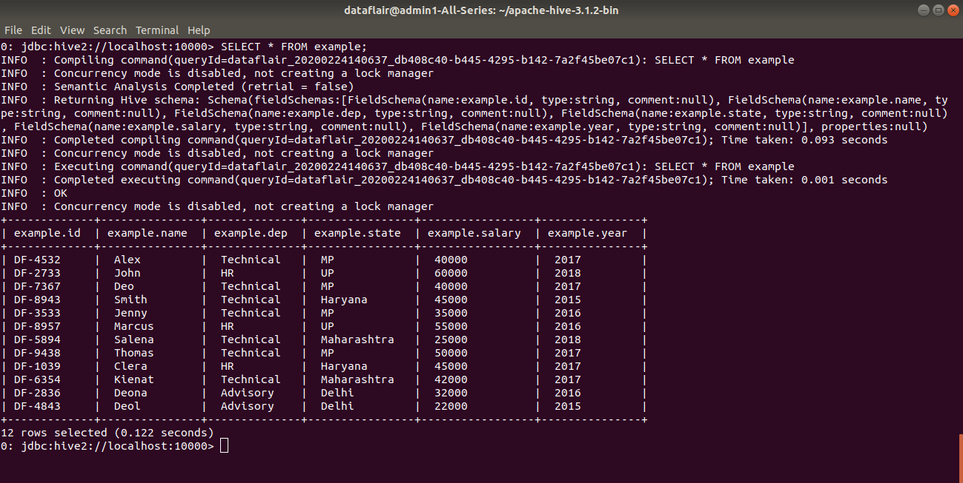

Slide 53
INSERT OVERWRITE TABLE tablename1 [PARTITION (partcol1=val1, ..) [IF NOT EXISTS]] select_statement FROM from_statement;
The INSERT OVERWRITE table overwrites the existing data in the table or partition.
INSERT INTO TABLE tablename [PARTITION (partcol1[=val1], partcol2[=val2] ...)] VALUES values_row [, values_row ...];
DELETE FROM tablename [WHERE expression];
The DELETE statement in Hive deletes the table data. If the WHERE clause is specified, then it deletes the rows that satisfy the condition in where clause.
The DELETE statement can only be used on the hive tables that support ACID.
EXPORT TABLE tablename [PARTITION (part_column="value"[, ...])]
TO 'export_target_path' [ FOR replication('eventid') ];The Hive EXPORT statement exports the table or partition data along with the metadata to the specified output location in the HDFS.

Slide 54
IMPORT [[EXTERNAL] TABLE new_or_original_tablename [PARTITION (part_column="value"[, ...])]]
FROM 'source_path' [LOCATION 'import_target_path'];

Slide 55
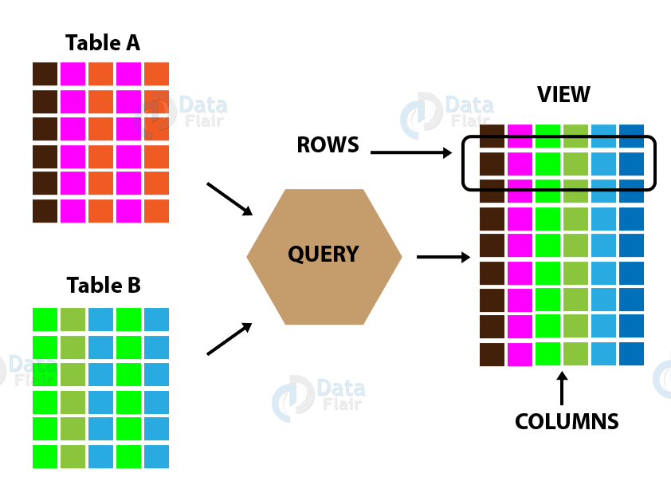
Hive view Basically, Apache Hive View is similar to Hive tables, that are generated on the basis of requirements.

Slide 56
As a Hive view, we can save any result set data.
Well, we can say its usage is as same as the use of views in SQL.
Although, we can perform all type of DML operations on Hive views.
In other words, Apache Hive View is a searchable object in a database which we can define by the query. However, we can not store data in the view. Still, some refer to as a view as “virtual tables”. Hence, we can query a view like we can a table.

Slide 57
CREATE VIEW [IF NOT EXISTS] view_name [(column_name [COMMENT column_comment], …) ]
[COMMENT table_comment]
AS SELECT …
hive> CREATE VIEW emp_35000 AS
SELECT * FROM employee
WHERE salary>35000

Slide 58
ID | Name | Salary | Designation | Dept
1201 | Michel | 45000 | Technical manager | TP
1202 | Chandler | 45000 | Proofreader | PR
1203 | Ross | 40000 | Technical writer | TP
1204 | Joey | 40000 | Hr Admin | HR
1205 | Monika | 35000 | Op Admin | Admin
DROP VIEW view_name
The following query drops a view named as emp_35000:
hive> DROP VIEW emp_35000;

Slide 59
Hive Data Model
Table
Partition
Bucket

Slide 60
Table
Managed Table
External Table
In Hive when we create a table, Hive by default manage the data. It means that Hive moves the data into its warehouse directory. Alternatively, we can also create an external table, it tells Hive to refer to the data that is at an existing location outside the warehouse directory.
CREATE TABLE managed_table (dummy STRING);
LOAD DATA INPATH '/user/tom/data.txt' INTO table managed_table;

Slide 61
This will move the file hdfs://user/tom/data.txt into Hive’s warehouse directory for the managed_table table, which is hdfs://user/hive/warehouse/managed_table.
if we drop the table using:
DROP TABLE managed_table
Then this will delete the table including its data and metadata. It bears repeating that since initial LOAD performed a move operation. And the DROP performed a delete operation. The data no longer exists anywhere. This is what it means for HIVE to manage the data.

Slide 62
External Table
The external table in Hive behaves differently. We can control the creation and deletion of the data. The location of the external data is specified at the table creation time:
CREATE EXTERNAL TABLE external_table (dummy STRING)
LOCATION '/user/tom/external_table';
LOAD DATA INPATH '/user/tom/data.txt' INTO TABLE external_table;
Now, with the EXTERNAL keyword, Apache Hive knows that it is not managing the data. So it does not move data to its warehouse directory. It does not even check whether the external location exists at the time it is defined. This very useful feature because it means we create the data lazily after creating the table.
An important thing to notice is that when we drop an external table, Hive will leave the data untouched and only delete the metadata.

Slide 63
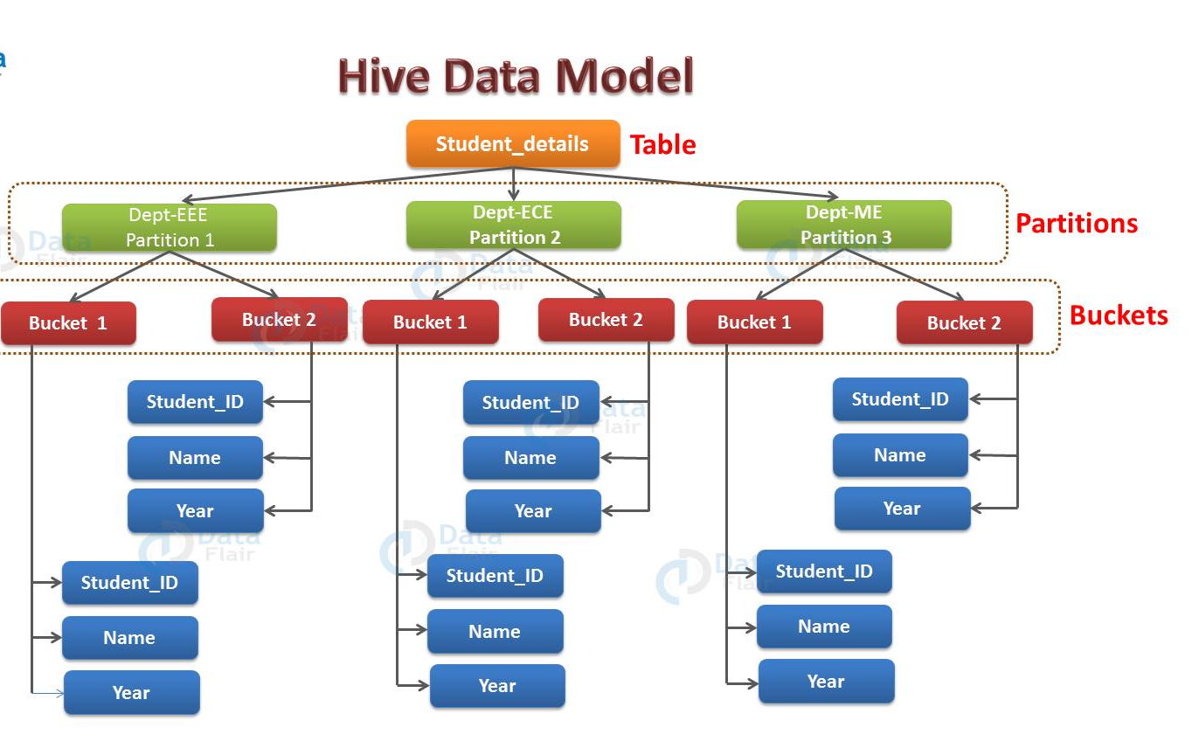
Partition

Slide 64
Apache Hive organizes tables into partitions for grouping same type of data together based on a column or partition key. Each table in the hive can have one or more partition keys to identify a particular partition. Using partition we can also make it faster to do queries on slices of the data.
Command:
CREATE TABLE table_name (column1 data_type, column2 data_type) PARTITIONED BY (partition1 data_type, partition2 data_type,….);
By example, we can understand partition. Consider you have a table student_details containing the student information of some engineering college like student_id, name, department, year, etc. Now, if you want to perform partitioning on the basis of department column. Then the information of all the students belonging to a particular department will be stored together in that very partition. Physically, a partition in Hive is nothing but just a sub-directory in the table directory.

Slide 65
Suppose you have data for three departments in our student_details table – EEE, ECE and ME. Thus you will have three partitions in total for each of the departments as you can see in the diagram below. For each department, you will have all the data regarding that very department residing in a separate subdirectory under the table directory.
So for example, all the student data regarding EEE departments will be stored in user/hive/warehouse/student_details/dept.=EEE. So, the queries regarding EEE students would only have to look through the data present in the EEE partition.
Hence, from above example, you can say that partitioning is very useful. Because it reduces the query latency by scanning only relevant partitioned data instead of the whole data set. In real-world implementations, you might be dealing with hundreds of TBs of data. So, you can imagine scanning this huge amount of data for some query where 95% data scanned by you was un-relevant to your query.

Slide 66
Buckets
In Hive, Tables or partition are subdivided into buckets based on the hash function of a column in the table to give extra structure to the data that may be used for more efficient queries.
Command:
CREATE TABLE table_name PARTITIONED BY (partition1 data_type, partition2 data_type,….) CLUSTERED BY (column_name1, column_name2, …) SORTED BY (column_name [ASC|DESC], …)] INTO num_buckets BUCKETS;
Each bucket in Hive is just a file in the table directory (unpartitioned table) or the partition directory. So, you have chosen to divide the partitions into n buckets. Then you will have n files in each of your partition directories. Hence, from the above diagram, you can see, where you have bucketed each partition into 2 buckets. Therefore each partition, say EEE, will have two files where each of them will be storing the EEE student’s data.

